Slide 1
MS in Cybersecurity - CS06
Name – Rajeev Kumar Singh
Module – 8 “Security Analytics”

Slide 2
Assignment
Analyze Botnet Behaviour
Business Case Study
  What is Botnet ?
  Mitigation technique ?
  Analysis open source or tools ?
    A botnet is a number of Internet-connected devices, each of which runs one or more bots. Botnets are hijacked devices used to carry out various scams and cyber attacks.
    A decade ago, it was bit hard to identify which one is affected device and how to identify its behaviour on network layer.
    Now, a days we have various method to do real-time analysis based on AI-ML and Python programming.
    In this case, I am using Juypter Notbook to identify Botnet behaviour using AI-ML model.

Slide 3
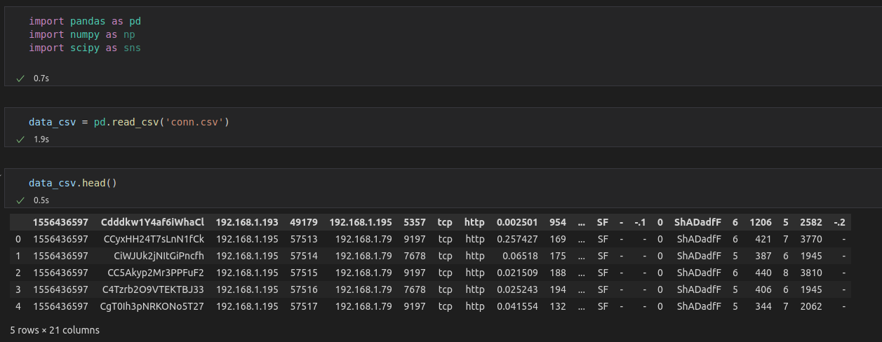
Before, analysing the network dataset. First, we have ensure the data which has been captured is sufficient to identify the behaviour and pattern.
Downloaded the Dataset from below url -
  https://cloudstor.aarnet.edu.au/plus/s/ds5zW91vdgjEj9i?path=%2FRaw_datasets%2FRaw_Network_dataset%2FNetwork_dataset_Bro%2FNetwork_normal_attack_Bro
At first level, we cleaning up the raw data and keeping what is needed to identify the botnet behaviour. In raw data, we could see there are 5 rows and 21 columns without heading.

Slide 4
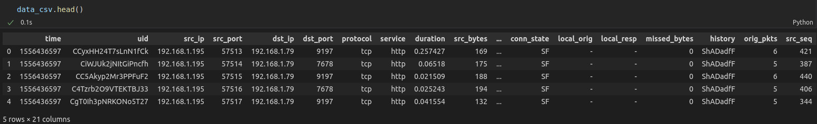
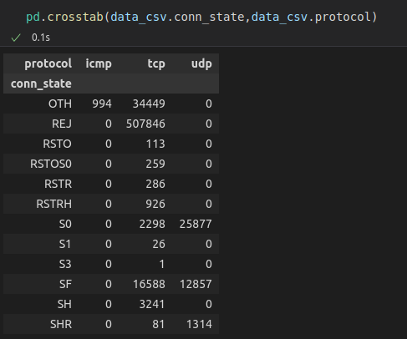

Let’s define columns name. The columns name is also important while passing the data for filter.
Filtering out variables for data sample and below data represents each protocol state and its behaviour. The data shape shows no. Of records and columns.

Slide 5
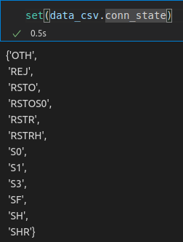
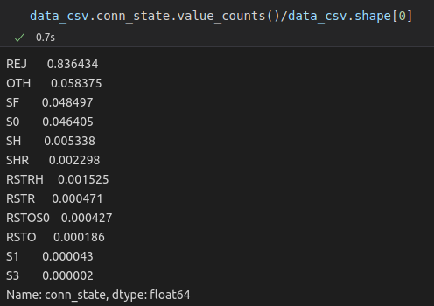
Here, i have selected connection state to identify the botnet detection.
Now, we have data classification and predection with %, how much packet has been rejected. The reason for selecting connection state is a good approach to understand connection state. REJ – in most scenerio it is used to detect an attack.

Slide 6

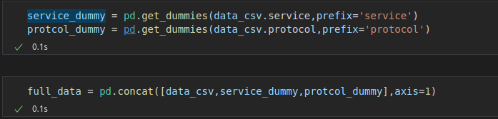

After analyzing the service most of the comman service shows as known port except “-”.
Creating a dummy dataset for data analysis and out of that we will use 30% of value for test and 70% for train data.
Dummy data set has been created and using sklean model for prediction to create decision tree.

